Slide 1

Arabic OCR
By Abdelrhman Wahdan

Slide 2
TABLE OF CONTENTS
01
02
03
04
05
06
Project Overview
Technologies Used
Model Workflow
API Functionality
Model Performance
Future Enhancements

Slide 3
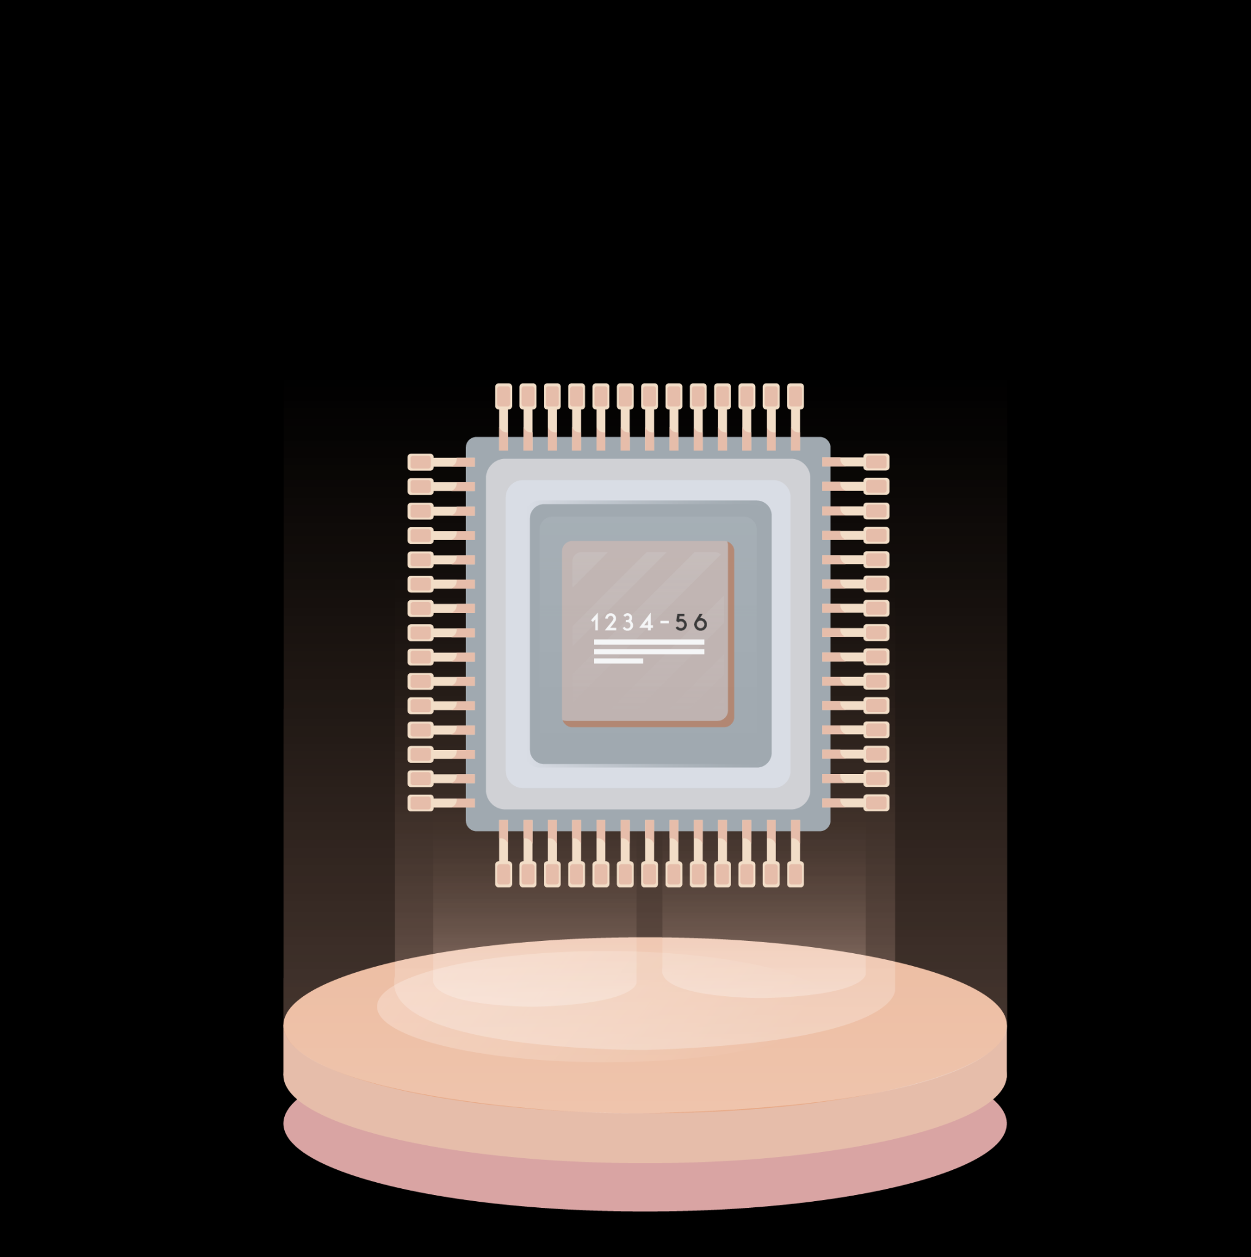
01
Project Overview

Slide 4
Project Overview
Objective: Detect and extract Arabic book titles from images.
Features:
Object detection using YOLOv8.
OCR and text correction using EasyOCR.
Spell and language correction with AraBERT.
REST API for easy image uploads and text extraction.

Slide 5
02
Technologies Used

Slide 6
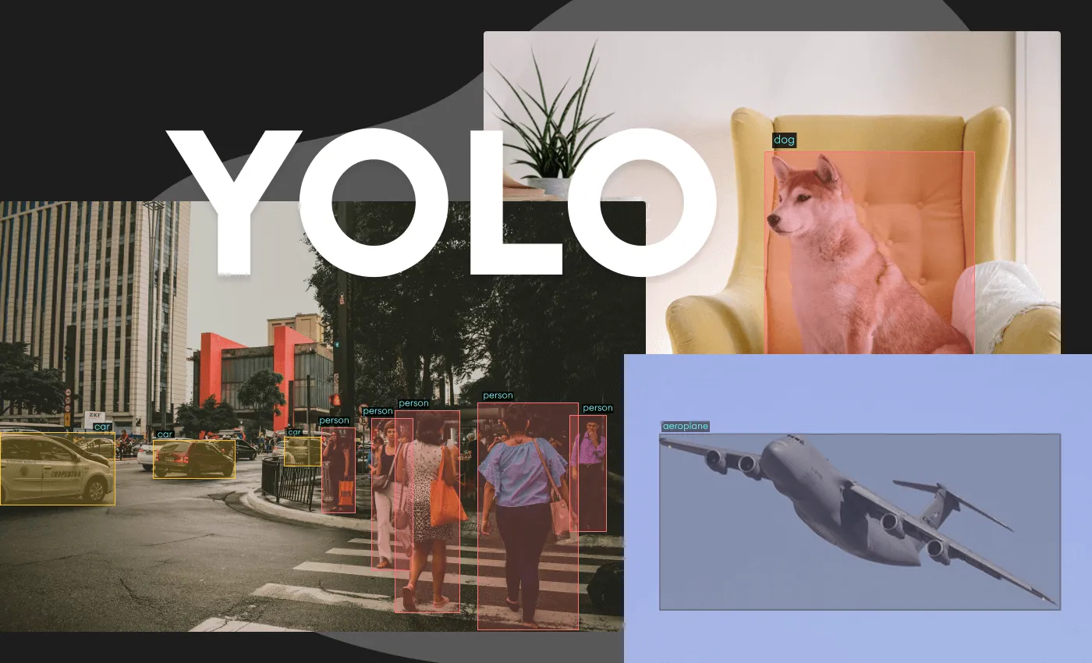
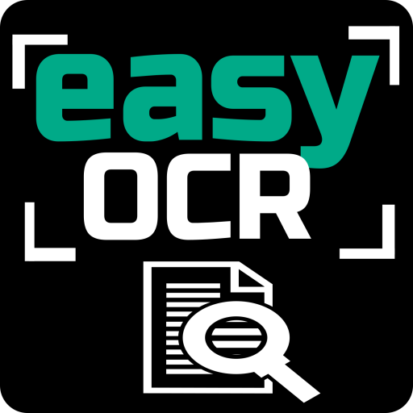

Technologies Used
YOLOv8
EasyOCR
AraBERT

Slide 7

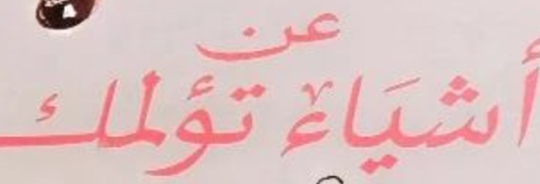
YOLOv8
YOLOv8 (You Only Look Once):
Detects objects in real-time using deep learning.
Fine-tuned for detecting 'Title' class.
Optimized for high precision and recall.
Supports various formats: PyTorch, ONNX, FP16.

Slide 8
EasyOCR
EasyOCR:
Optical Character Recognition (OCR) for Arabic text.
Capable of handling complex scripts.
Extracts text from detected regions (bounding boxes).

Slide 9
Spell Check and AraBERT
SpellChecker:
Corrects spelling errors in Arabic text.
BERT Language Model:
Provides context-aware text correction.
Fine-tuned for Arabic using AraT5.

Slide 10
03
Model Workflow

Slide 11
Model Workflow
Step 1: YOLO detects the title in the image.
Step 2: Extract region of interest (ROI) based on bounding box.
Step 3: Perform OCR on the ROI using EasyOCR.
Step 4: Correct the text using SpellChecker and AraBERT model.
Step 5: Return the corrected text and bounding box details.

Slide 12
04
API Functionality

Slide 13
API Functionality
/predict/ Endpoint:
Accepts image uploads.
Returns bounding box coordinates and extracted/corrected text.
JSON response format.
Dockerized Application:
Easily deployable via Docker.
Runs the FastAPI server in a container.

Slide 14
05
Model Performance

Slide 15
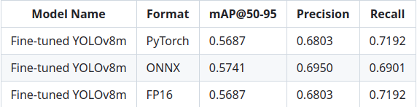
Model Performance

Slide 16
06
Future Enhancements

Slide 17
Future Enhancements - Training
Longer Training:
The current model was trained for only 10 epochs due to time and computational limitations.
Increasing the number of epochs can significantly improve model accuracy and performance.
Fine-tuning on a larger dataset could yield even better results.

Slide 18
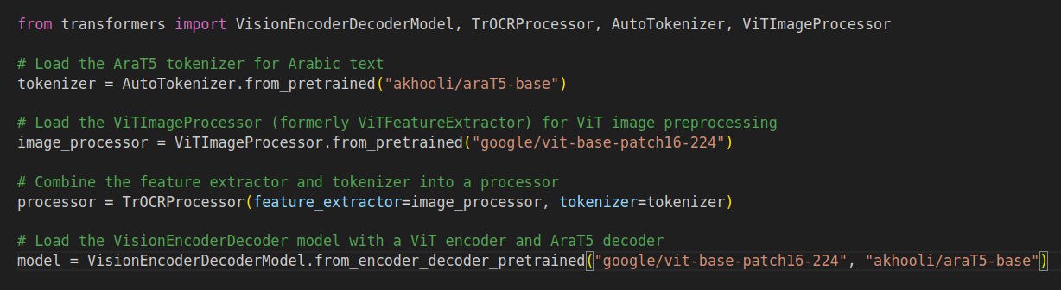
Future Enhancements - Advanced Models
Advanced Architectures:
Explore VisionEncoderDecoder models, combining Vision Transformers (ViT) with AraT5 as the decoder

Slide 19


